Slide 1
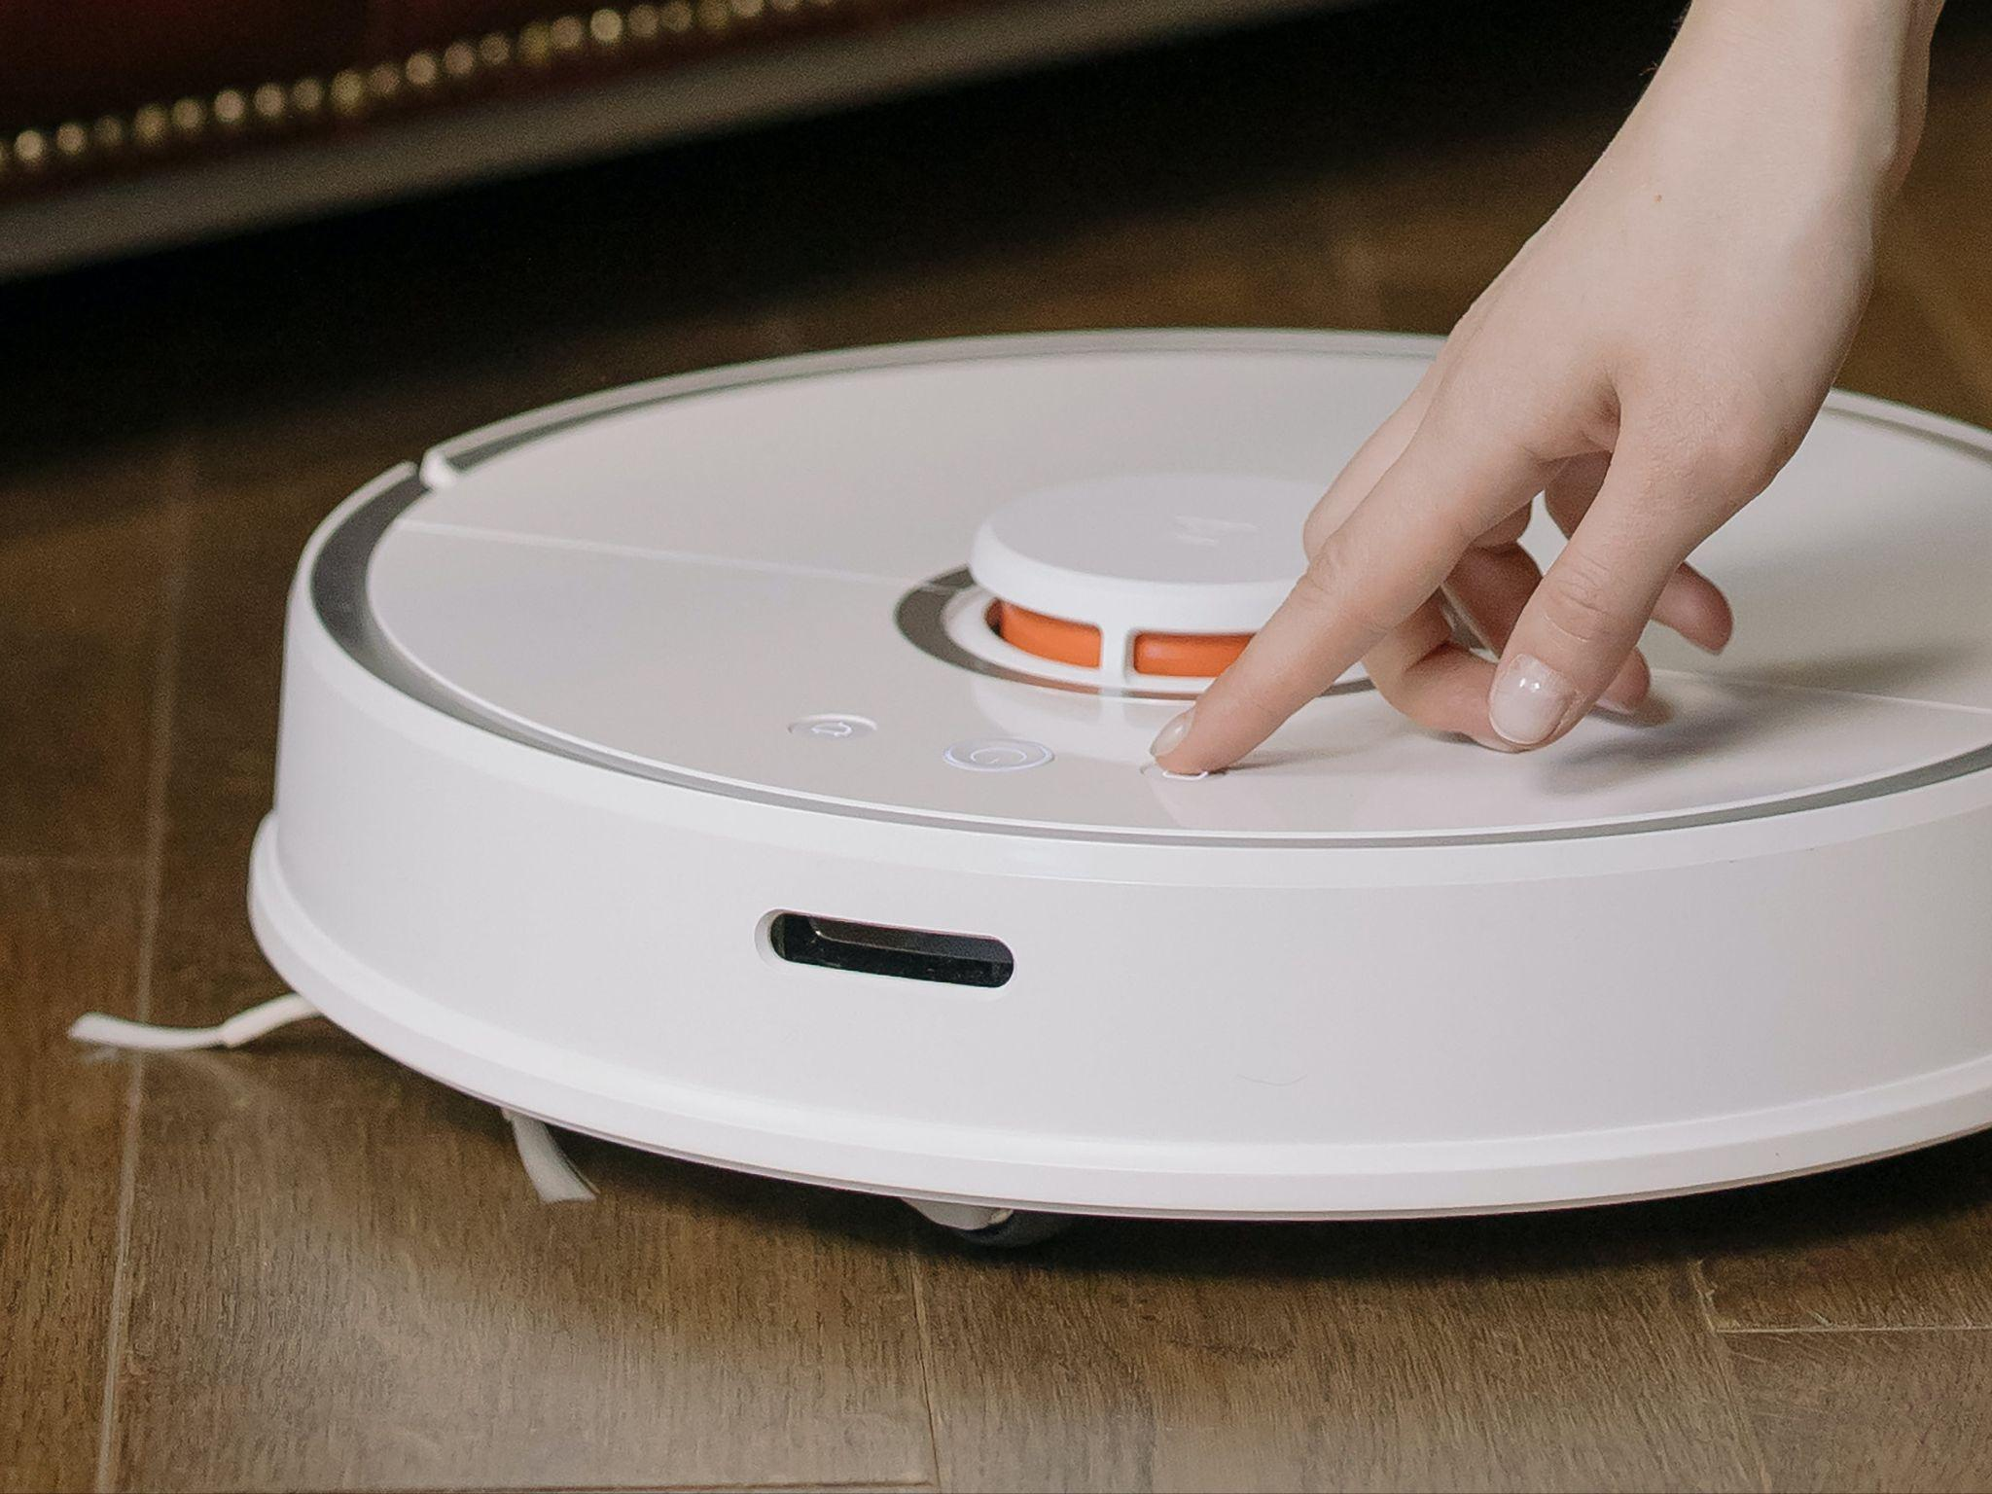
Robotic
Vacuum Cleaner
Guide - Prof. Veeresh Deshpande
Alok Kumar 210070006
Arya Agarwal 210070012
Sumit Londhe 210070089
Yabaji Pratik Sanjay 210070094
Image from pixel.com
MON-02
Notes:
Good [afternoon], everyone! I hope you're all doing well. My name is [Your Name], and I'm excited to be here today to walk you through our project, the "Robotic Vacuum Cleaner," under the guidance of Professor Veeresh Deshpande. Along with me, are Arya Agarwal, Sumit Londhe, and Yabaji Pratik Sanjay. Today, we're going to explore the fascinating world of robotic vacuum cleaners. Let's dive in!

Slide 2
Outline
Problem statement
Proposed solution and target specification
Methodology
Technical Details
Week-wise goals
Key risks and mitigation strategies
Expected outcome of projects
Notes:
To guide our exploration today, let's look at what we'll cover: We start with the Problem Statement,then go on to present our Proposed Solution and Technical Specifications, then Methodology to solve and build it, Technical Details regarding each technical items we are using, Week-wise Goals, Key Risks and Mitigation Strategies, and Expected Outcome of the Project. Let's start by understanding the challenge we aimed to address.

Slide 3
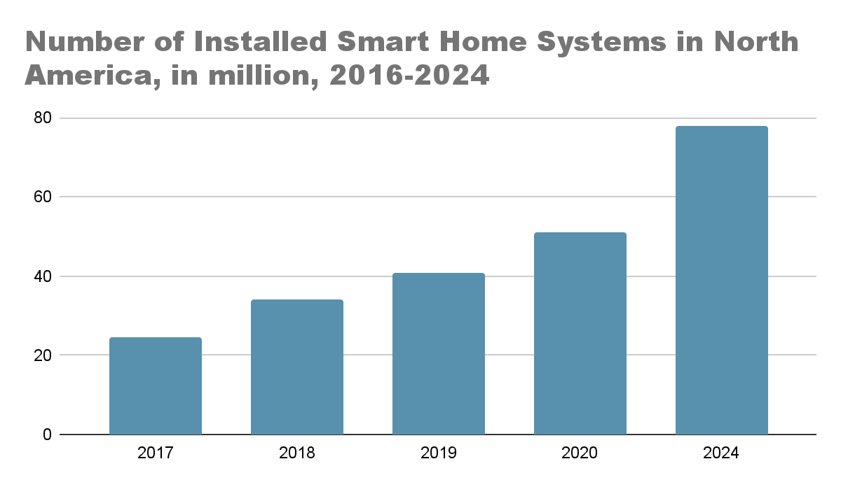
Introduction
Robotic vacuum cleaners represent a significant advancement in home cleaning technology.
They offer convenience and efficiency, automating the process of floor cleaning.
Robotic cleaners save time and effort, aligning with modern lifestyles.
The demand for robotic solutions in home automation is steadily increasing.
https://www.mordorintelligence.com/industry-reports/robot-vacuum-cleaners-market
Notes:
Robotic vacuum cleaners are not just cool gadgets; they're like a big leap forward in how we clean our homes.
A device that not only cleans your floors automatically but does it in a super cool and futuristic way.
As life gets busier, and we all want things to be easy, these robotic cleaners help saving us time and effort.
What's even cooler is that more and more people want these kinds of smart solutions for their homes (you can check that here).
Think about having perfectly clean floors without doing anything yourself. It's not just a trend; it's like a big change in how we think about doing chores at home. Today, we're going to explore our own smart vacuum cleaner project. We're not just fixing a problem; we're part of a tech change that's making our homes cleaner and smarter.
So, let's dive into our project, look at the main issues we wanted to solve, and see the smart solutions we came up with to make your home a cleaner, smarter, and more awesome place to live. Let's get to the heart of it and understand what our project is all about.

Slide 4
Problem statement
Developing an autonomous vacuum cleaner to address the inefficiencies and limitations of traditional cleaning methods, providing users with a hands-free and intelligent solution for efficient floor cleaning in diverse household environments.
Notes:
Starting this journey, we noticed the problems with old-fashioned ways of cleaning floors. Imagine a world where cleaning isn't just a job but a smart and easy process. Our goal: to make a vacuum cleaner that works by itself, going beyond the usual cleaning methods. It's not just a new version; it's like taking a big step into a future where your cleaning helper is super smart, adjusts to your needs, and changes how we take care of our homes. So, as we talk about our solution, remember we're not just fixing a problem; we're making the future of keeping our homes clean.

Slide 5

Proposed solution and
Technical specification
Notes:
Now that we've dissected the challenges, let's unravel our ingenious solution and the intricate technical specifications that make it a game-changer. Imagine a vacuum cleaner not confined to mere suction but equipped with features that elevate it to a sophisticated home maintenance assistant.

Slide 6
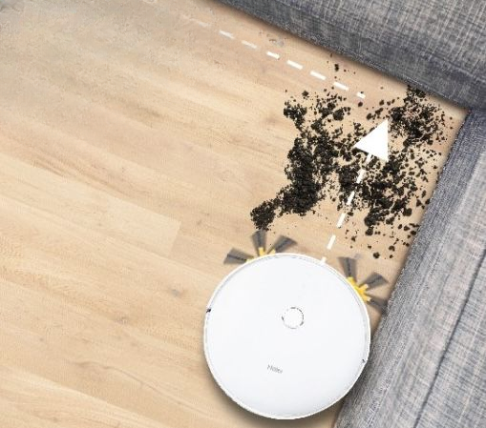
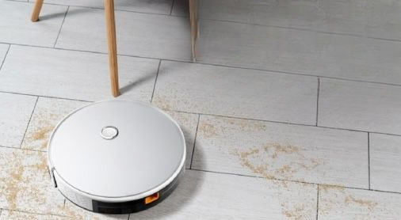
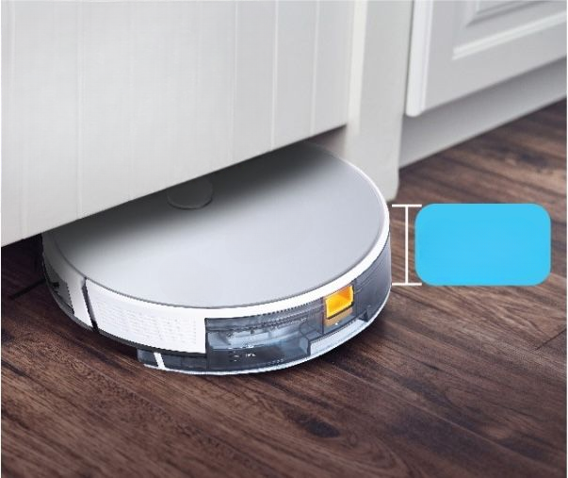
Edge Cleaning and Spot Cleaning
Add two small rotating brushes in front to increase cleaning coverage,especially in corners and edges. This design improves overall cleaning effectiveness but might raise maintenance needs and costs
Mopping
Incorporating a simple mopping feature on the back of the vacuum with a water tank on top allows for wet cleaning capabilities. This addition enhances the robot's functionalities, offering both dry and wet cleaning options for different floor surfaces and cleaning needs
Sleek Design
Design height such that easily slips under furniture while offering slightly more storage capacity . However, its compact size reduces the volume available for storing dust, requiring more frequent emptying.keeping this in mind a decent approximation is about 76mm
Notes:
Now, let's talk about the cool things we've planned to add to our vacuum cleaner design:
1. **Edge and Spot Cleaning:** We will be adding small brushes that spin around and reach into corners, making sure we clean all those tricky spots that normal vacuums miss.
2. **Mopping Feature:** Our vacuum not only cleans without water but also has a mopping feature. It can clean both dry and wet, working on different types of floors. It's like a cleaner with extra skills!
3. **Sleek Design:** Our vacuum is super sleek, sliding easily under furniture. It also has more space to collect dirt. But, because it's so compact, you might need to empty it a bit more often. It's a small thing to do for a cleaner that works so well.

Slide 7
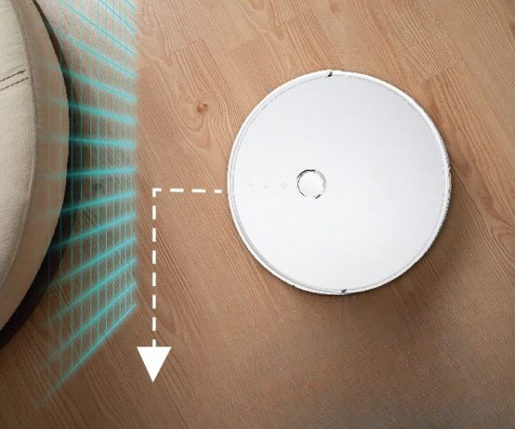
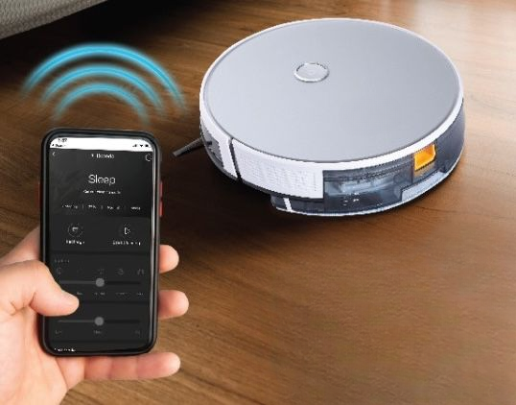
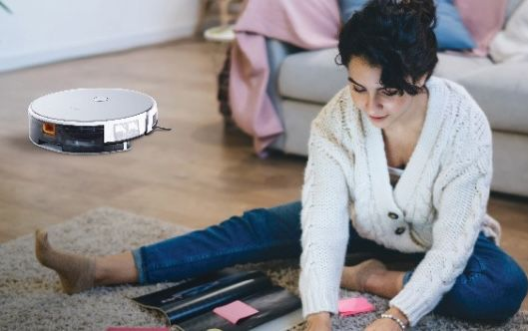
Detects Obstacle
Equip vacuum cleaner with supersonic sensors that enable it to detect obstacles such as walls, furniture, and other surfaces. This helps the cleaner maneuver around obstacles effectively, preventing collisions and ensuring efficient cleaning
Listens to Your Phone
With the Smart App, you can easily control and operate your Robo from anywhere using a user-friendly mobile application. This adds convenience by allowing you to manage the cleaning process remotely
Schedule Cleaning Time
The Mobile App helps you to schedule cleaning your home from anywhere in the world. You can set your alarm and the vacuum cleaner automatically starts cleaning.
Notes:
Obstacle Detection: We will integrate it with supersonic sensors, our cleaner intelligently maneuvers around obstacles, preventing collisions and ensuring thorough cleaning.
Smart Connectivity: Enabling control via a user-friendly mobile app, our vacuum not only listens to your phone but also follows your schedule. Imagine a cleaner that adapts to your lifestyle, autonomously starting its cleaning routine at your convenience.
As we dive deeper into our methodology and technical details, envision not just a vacuum cleaner but a meticulously designed cleaning companion revolutionizing how we perceive home automation.

Slide 8

Methodology
Notes:
Now I'll talk about the methodology we'll be using for our project

Slide 9
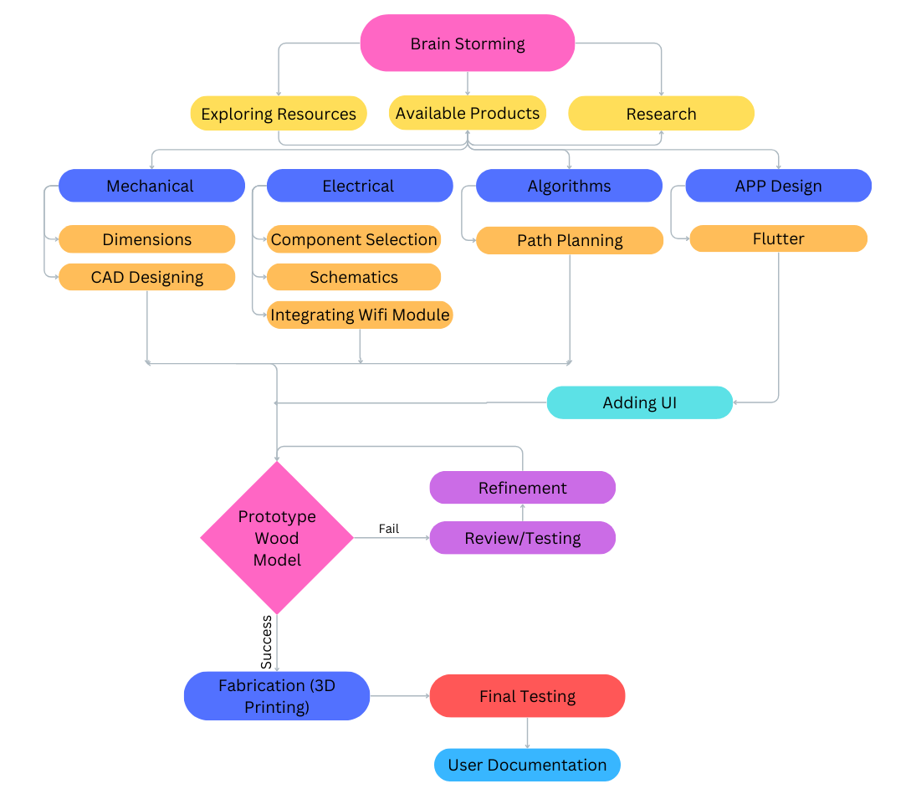
FlowChart
Notes:
Now I'll talk about the methodology we'll be using for our project
This flow chart illustrates the workflow of our project
We begin with collaborative brainstorming, which involves exploring available resources and products, as well as conducting research and literature surveys on the designs and functionalities of models available in the market
"Next, we divide our process into subtasks based on mechanical, electrical, algorithm, and app development.
In our mechanical phase, we'll define dimensions and weight based on specifications and design a CAD model for visualization. Electrical tasks involve selecting components, designing circuit schematics, and integrating a WiFi module. Algorithm work focuses on path planning and optimization. As for app development, our initial task is to learn Flutter and become familiar with it to create our app. Then we will make a prototype model from wood and Assembleing the mechanical and electronic components into a final prototype and conductiterative testing and refinement .
After a satisfactory number of tests we proceed to fabrication. Then next final testing and then documentation
// Also explain the chart in little bit detail.

Slide 10



Research
Collaboratively gather information by doing research on existing robotic vacuum cleaners and their features to understand common functionalities and requirements.
Work Segmentation
Break down the project into manageable tasks and subtasks, considering the timeline, resource availability, and dependencies. Utilize project management tools such as Gantt charts to organize tasks, set deadlines, and track progress effectively.
Skill-Based Task Sharing
Segment the process into mechanical, electrical, and software subsystems to work effectively. Allot that tasks based on team members' skills and interests.
Notes:
//Explain point wise
Research Breakdown: Breaking down the project into manageable tasks and subtasks, we considered timelines, resource availability, and dependencies. This approach facilitated effective organization through tools like Gantt charts.
Segmented Development: To maximize efficiency, we segmented the process into mechanical, electrical, and software subsystems, assigning tasks based on the team's skills and interests.

Slide 11



Component Selection
Identify , compare and select good quality and low cost components like motors, sensors, brushes, batteries, and microcontrollers suitable for our vacuum cleaner design, based on there availability and other dependencies.
Prototype
Develop rough designs and prototypes of the robotic vacuum cleaner using software like Fusion 360, Solid work, etc and design the electronic circuits, sensor interfaces, and control algorithms required for autonomous navigation, obstacle detection, and cleaning operations.
Testing
Assemble the mechanical and electronic components into a final prototype and conduct rigorous tests to evaluate performance, reliability and other such matrices.
Notes:
3. Component Selection: Rigorous research identified quality and cost-effective components, ensuring optimal performance. Components like motors, sensors, brushes, batteries, and microcontrollers were carefully chosen based on availability and dependencies.
4. Design Prototyping: Using software like Fusion 360 and SolidWorks, we developed rough designs and prototypes. Simultaneously, electronic circuits, sensor interfaces, and control algorithms were meticulously designed for autonomous navigation, obstacle detection, and cleaning operations.

Slide 12


Optimization
Iterate on the design based on testing feedback like ,cleaning time and efficiency ,to address any issues or limitations identified during the testing phase. Optimize the performance through iterative refinements and enhancements.
Documentation
Document the entire development process, including design schematics, software code, test results, and user manuals. Prepare presentations and demonstrations to showcase the features, capabilities, and benefits of the robotic vacuum cleaner to stakeholders and potential users
Notes:
5. Optimization and Documentation: Iterations based on testing feedback were crucial for optimizing performance, addressing issues, and enhancing efficiency. The entire development process, including design schematics, software code, test results, and user manuals, was meticulously documented.
6. Presentation Preparation: Our journey's culmination involved preparing comprehensive presentations and demonstrations. These showcase the features, capabilities, and benefits of our robotic vacuum cleaner to stakeholders and potential users, ensuring a transparent and informative interaction.
Assembling and Testing: The mechanical and electronic components seamlessly came together in a final prototype. Rigorous testing evaluated performance, reliability, and various matrices to refine our design iteratively.
As we dive into the technical details, envision not just a vacuum cleaner but a well-thought-out solution shaped by meticulous research, collaborative effort, and a commitment to innovation.

Slide 13
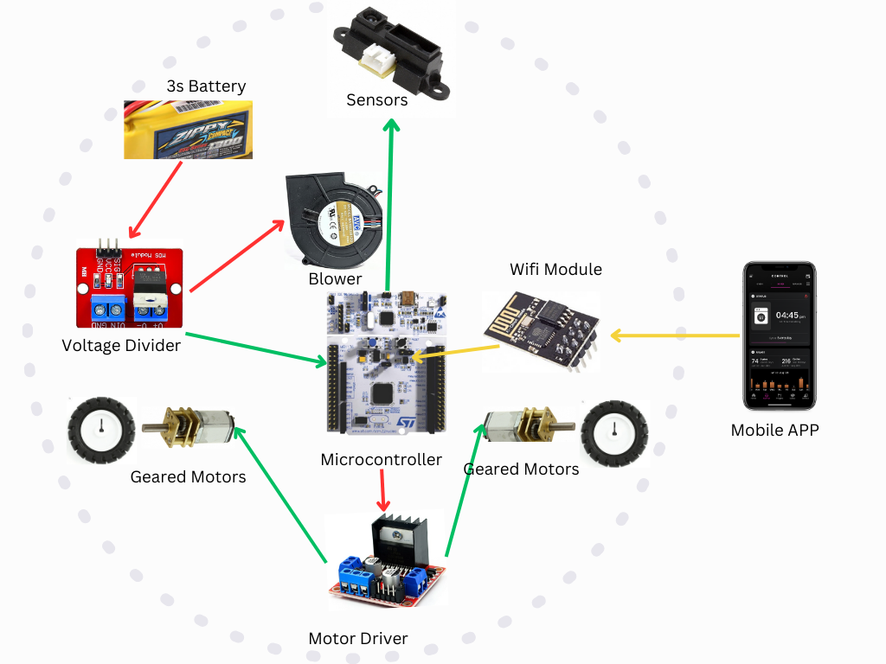
Model Design

Slide 14

Technical Details
Notes:
Now we dive into the technical details of the vacuum cleaner by bisecting through it. We have carefully designed the structure, choose correct components that fit to our requirements as well as to the model.

Slide 15
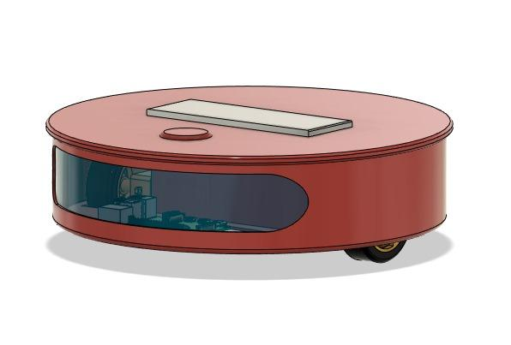
Design
01
1
Body Dimensions: 300mm x 300mm x 80mm
Bin Capacity: (540ml) 150mm x 60mm x 60mm
Water Tank: (300ml) 100mm x 50mm x 60mm
Made on Fusion360

Slide 16
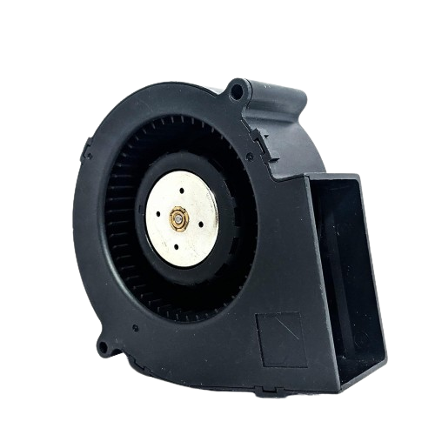
Vacuum Motor
02
1
Efficient suction power with optimal balance.
Minimal noise output for a quieter operation.
Seamlessly integrated into the vacuum cleaner design.
Smart control for adjustable suction based on the environment.
Voltage DC 12V Current 4.50A Speed 6000 RPM Noise 65.6dB Air Flow 51.9 CFM (0.910m³/min) Dimensions 97x97x33mm
Model no. BA10033B12G-P043
Notes:
Now, let's talk about the powerful engine that makes our smart vacuum cleaner work - the Vacuum Motor. This motor is great at cleaning efficiently and quietly. It runs on 12 volts of electricity, drawing 4.50 amps, and spins at 6000 rotations per minute (RPM). The noise it makes is not too loud, just 65.6 decibels. It ensures the air flows well, about 51.9 cubic feet per minute (CFM), making your living space not only clean but also quiet and peaceful. The motor is compact, with dimensions of 97x97x33mm, adding to the sleek look of our cleaner. So, it's not just a part; it's like the heart that makes our cleaner redefine how we take care of our homes

Slide 17
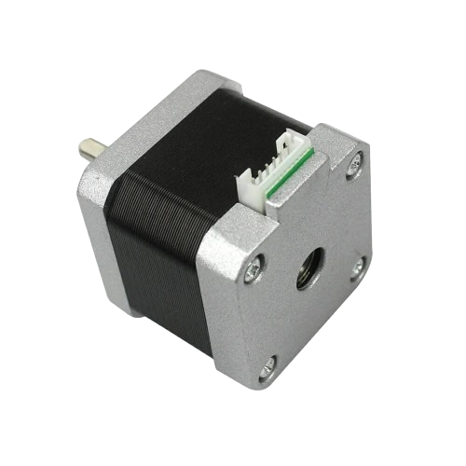
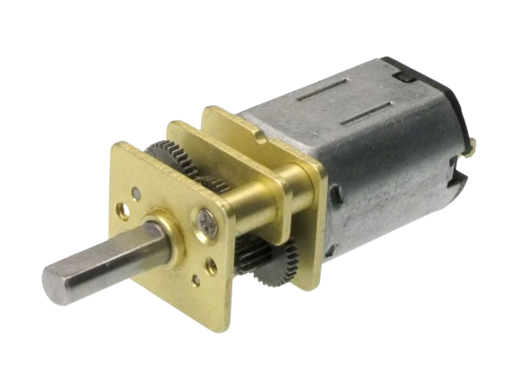
Gear Motor V/s Stepper Motor
N20 Micro Gear 12V 100RPM DC Motor
DC motors can be efficient, especially with geared versions that optimize torque and speed. However, efficiency can vary based on the design.
DC motors, including geared versions, are often more cost-effective.
N20 motors are known for providing high torque, which is beneficial for applications requiring power, such as driving wheels in small robots.
NEMA17 Stepper Motor–D-Type Shaft
Stepper motors may be less power-efficient, especially at higher speeds or when holding a position without movement.
Stepper motors and their associated control systems can be more expensive.
The NEMA17 stepper motor specified here has a higher holding torque (4.2 kg-cm), which can be advantageous for applications where maintaining a position is important.
Notes:
Choosing the right motor is critical, and our decision-making process involved weighing the benefits of two contenders: the N20 Micro Gear 12V 100RPM DC Motor and the NEMA17 Stepper Motor–D-Type Shaft. The N20 Micro Gear Motor, a cost-effective choice, stands out for its efficiency and high torque - ideal for powering small robots. On the other hand, the NEMA17 Stepper Motor, while potentially less power-efficient at higher speeds, boasts a higher holding torque of 4.2 kg-cm, crucial for maintaining positions. Our decision wasn't just about efficiency; it was about ensuring the right balance for our specific application.

Slide 18
Wheel Motor
03
1
The motor delivers high torque, making it suitable for applications requiring strength and power, such as moving heavy loads or driving wheels effectively.
Equipped with a gearbox assembly to amplify torque and enhance the motor's performance in handling increased loads, providing efficiency and durability.
Voltage DC 12V Speed 100 RPM Torque 0.52 Kg-cm Dimensions 97x97x33mm
Model no. N20-12-100
Notes:
the wheels of our smart vacuum cleaners are powered by the N20-12-100 Wheel Motor. It works with 12 volts of electricity and can spin at a speed of 100 rotations per minute (RPM). What makes this motor special is not just how fast it can go but its ability to handle heavy things really well. It's equipped with a gearbox assembly, which is like a special gear system that makes it even more powerful. This feature helps the motor handle tough jobs efficiently, making it more than just a motor; it's the force that drives our cleaner, making it great at handling various cleaning tasks effectively.

Slide 19
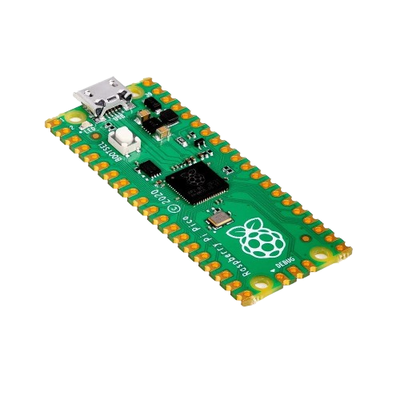
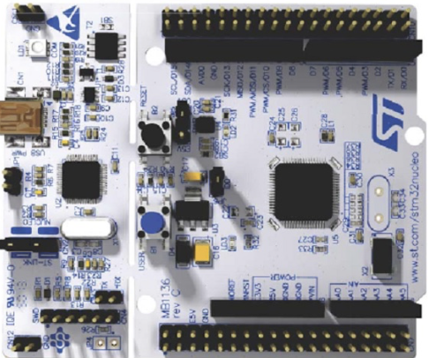
STM32 V/s Raspberry Pi Pico
STM32F103VCT6TR
The STM32 series is known for its rich set of integrated peripherals, including timers, communication interfaces (UART, SPI, I2C), ADC, and more.
STM32 microcontrollers, especially those based on Cortex-M4 or Cortex-M7 cores, offer higher processing power.
The STM32 series benefits from a well-established and extensive development ecosystem
RP2040 Raspberry Pi Pico
The RP2040 also has a good set of peripherals, but the specific peripherals and features may differ.
RP2040 has a lower processing power as compared to the STM32 microcontroller.
The RP2040, while relatively new compared to the STM32 series, does not have an extensive development ecosystem as compared to STM32.
Notes:
//speaker says

Slide 20
Microcontroller
STM32
04
The microcontroller is equipped with features specifically designed for motor control applications. This can include peripherals and hardware accelerators that enhance the control of motors, making it suitable for applications like robotics.
The microcontroller supports the Controller Area Network, a communication standard often used in automotive and industrial applications. CAN allows for robust and efficient communication between devices in a network.
Clock Speed : 72MHz Flash Memory: Up to 1 Mbyte
Model no. STM32F103VCT6TR
Notes:
Now, let's focus on the brain orchestrating the entire operation - the STM32 Microcontroller. Operating at a clock speed of 72MHz with a flash memory capacity of up to 1 Mbyte, the STM32F103VCT6TR stands out for its features tailored for motor control applications. It supports the Controller Area Network (CAN), a communication standard vital for robust and efficient communication in networks. This microcontroller isn't just processing; it's orchestrating a symphony of efficient and intelligent cleaning.

Slide 21
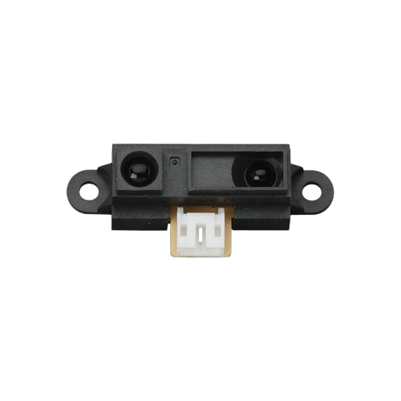
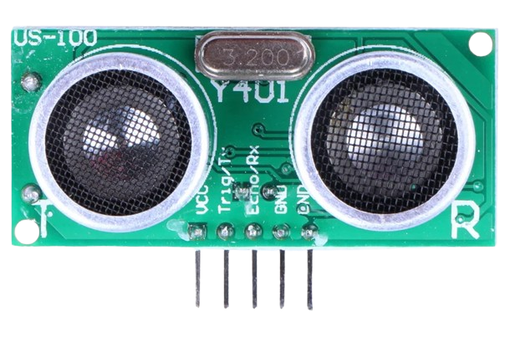
IR Sensor V/s Ultrasonic Sensor
IR sensors use infrared light to measure the distance. They emit infrared light pulses and measure the time taken for the pulses to reflect back from an object.
Typically have a shorter range compared to ultrasonic sensors.
Ultrasonic sensors use ultrasonic waves to measure distance. They emit ultrasonic pulses and measure the time it takes for the sound waves to bounce back.
Offer a longer detection range, making them suitable for both short and long-distance measurements.

Slide 22
Sensors
05
1
The sensors contribute to the robotic vacuum cleaner's intelligent navigation by effectively detecting obstacles, ensuring collision-free movement.
Their design enables the vacuum cleaner to navigate seamlessly through confined spaces, enhancing overall cleaning efficiency.
Range 0.78 to 196 inches/(2 cm to 500 cm) Accuracy Up to 0.12 inches (0.3 cm) Angle Less than 15 degrees

Slide 23
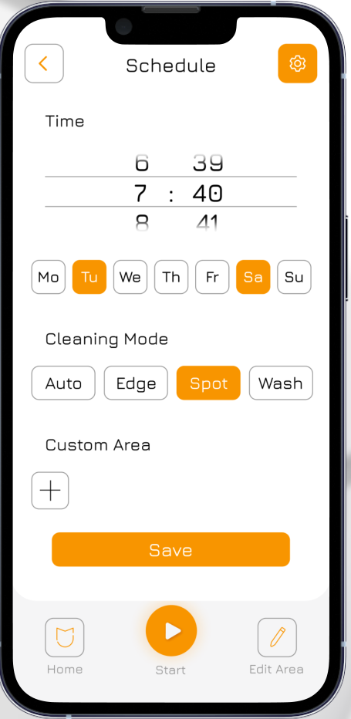
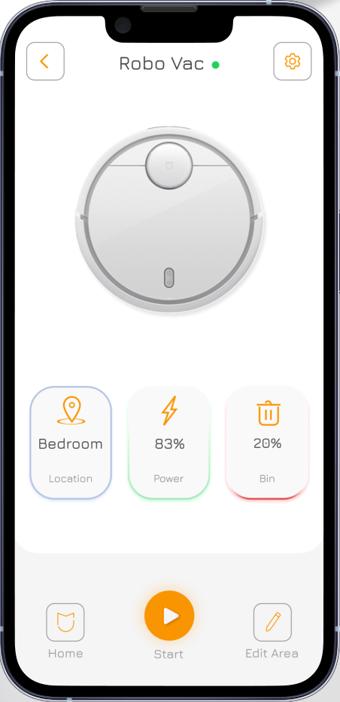
App
06
Building a user-friendly Flutter app to control the vacuum cleaner such as easily turn the vacuum cleaner on or off through the app for quick control.
Allow users to set specific cleaning schedules for the robotic vacuum cleaner, offering flexibility and convenience.
Keep users informed about the vacuum cleaner's battery status within the app, ensuring they can plan charging accordingly.
Enable manual control of the vacuum cleaner's movement and direction through the app, providing users with hands-on control options.
Notes:
Enter the realm of user empowerment through technology - our User-friendly Flutter App. Envision a world where you control your cleaner effortlepersonalizedur mobile device. The app not only allows you to turn the vacuum cleaner on or off with a tap but also provides the flexibility to schedule cleaning sessions at your convenience.
Key features include:
Scheduled Cleaning: Plan your cleaning routines from anywhere globally, setting alarms for automatic activation.
Battery Status Monitoring: Keep tabs on your cleaner's battery life through the app, ensuring timely recharging.
Manual Control: Take charge of your cleaner's movement and direction manually, offering a hands-on cleaning experience even when you're not at home.
This app isn't just a remote control; it's a gateway to personalized cleaning, adapting to your schedule and preferences.

Slide 24

Week-wise Goals

Slide 25
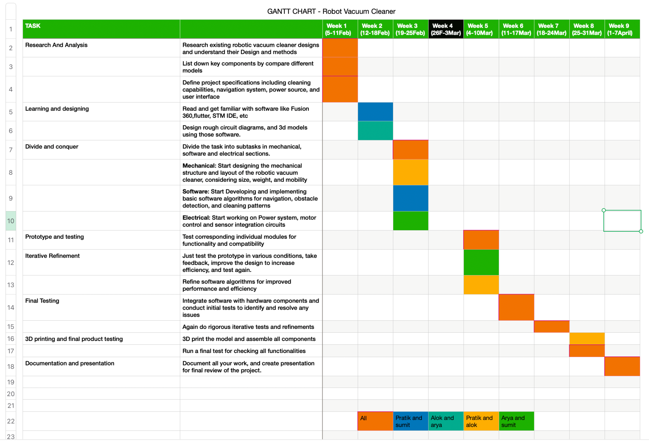
Gantt chart
Notes:
Think of our project timeline like a map that shows how we're progressing each week. It's like a special chart called a Gantt Chart. We planned every step carefully, and each part contributes to making our project successful.
Here's our journey, step by step:
1. **Research and Learning:** We started by studying existing robotic vacuum cleaners to understand how they work.
2. **Breaking Down the Project:** We then divided the project into smaller tasks, thinking about timelines, resources, and what we needed.
3. **Dividing into Teams:** We split the work into three parts - one for the physical parts, one for the electrical stuff, and one for the software. This way, everyone worked on what they were good at.
4. **Choosing the Right Parts:** We picked the best-quality parts that weren't too expensive, making sure they were available and worked well together.
5. **Making a Prototype:** Using special computer programs, we made a rough design of our vacuum cleaner to see how everything fits together.
6. **Putting it Together and Testing:** We built the actual vacuum cleaner with all its parts and tested it a lot to see if it works well.
7. **Making it Better:** Based on our tests, we made changes to the design to make it work even better. This is called optimization.
8. **Writing Everything Down and Getting Ready to Show:** We wrote down every single thing we did - how we designed it, the tests we did, and everything. We also got ready to show it to other people in presentations and demos.
Our journey is more than just a bunch of tasks. It shows how we worked together in a planned way to make our project a success.

Slide 26
KEY RISKS
MITIGATION STRATEGIES
Microcontrollers can be damaged if they are not installed correctly. This can happen if the microcontroller is not soldered properly, if the wrong voltage is applied, or if the microcontroller is exposed to static electricity.
Microcontrollers are programmed by software, and software can contain bugs. These bugs can cause the microcontroller to behave in unexpected ways, which could damage the microcontroller or other devices.
Accumulation of dust and contaminants can reduce the efficiency of the fan and lead to failure.
Gear motors and battery can overheat if they are not used properly. This can lead to a fire.
Follow the manufacturer's instructions carefully: The manufacturer's instructions will contain important information on how to install and use the microcontroller safely.
Test your code thoroughly: Before you deploy your code to the microcontroller, you should test it thoroughly to make sure that it is free of bugs.
Regularly clean the fan and its surroundings to prevent dust buildup.
Do not overload the motor and battery. Use them in a well-ventilated area. Monitor them regularly for signs of overheating, such as smoke or unusual smells.
Notes:
As we explore the innovative facets of our cleaner, it's vital to address potential pitfalls and have strategies in place to navigate them.
Key Risks and Mitigations:
Microcontroller Installation Risks: Mitigated by meticulous adherence to manufacturer's instructions.
Software Bugs: Minimized through thorough pre-deployment testing to ensure bug-free code.
Dust Accumulation: Regular cleaning of the fan and surroundings to prevent efficiency reduction.
Overheating of Gear Motors and Battery: Managed by avoiding overload, ensuring proper ventilation, and regular monitoring for signs of overheating.
These are not just risks; they are challenges met with strategic planning and proactive measures.

Slide 27
Expected Deliverables
A fully functional robotic vacuum cleaner prototype capable of autonomously navigating and cleaning floors.
Detailed documentation and specifications for the vacuum cleaner's hardware components, including the vacuum motor, wheel motors, sensors, and any other essential parts.
The robotic vacuum cleaner's software system, including the control algorithms, navigation system, and any other software components.
Design and implementation of a user-friendly interface, through a mobile app for remote control and monitoring.
Notes:
Functional Prototype:
Our primary goal is to present a fully functional robotic vacuum cleaner prototype. This device is engineered to autonomously navigate and clean floors, offering a modern and efficient cleaning solution.
Hardware Documentation:
We'll provide comprehensive documentation on the hardware components, including the vacuum motor, wheel motors, sensors, and other crucial parts. This detailed breakdown ensures a clear understanding of the inner workings of our robotic cleaner.
Software System:
The intelligence behind our robotic cleaner lies in its software system. We're delivering a complete software package encompassing control algorithms, navigation systems, and all the necessary software components for optimal performance.
User-Friendly Mobile App:
Enhancing user experience is a priority for us. We're designing and implementing a user-friendly mobile app for seamless remote control and monitoring. This app empowers users to manage the vacuum cleaner effortlessly.

Slide 28
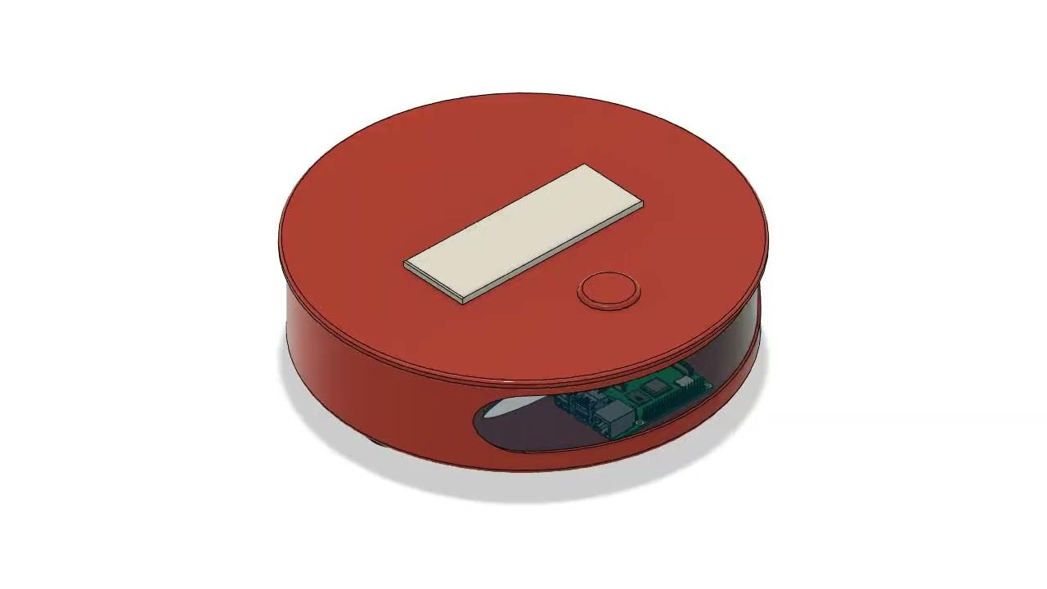
Made on Fusion360

Slide 29
References
Github link
https://www.instructables.com/CleanBOT/
https://www.instructables.com/Build-Your-Own-Vacuum-Robot/
https://www.myminifactory.com/object/3d-print-101108
Notes:
Acknowledging the roots of our knowledge and progress, our journey is anchored in references and resources. Our GitHub link (Provided Link) is a repository of collaborative effort, a testament to the collective wisdom that has shaped our project.
As we conclude this exploration, keep in mind that we're not just presenting a project; we're sharing a vision of the future of home maintenance. Thank you for joining us on this insightful journey.

